Slide 1
MULTITHREADING

Slide 2


What is Thread ?

Slide 3
What is Thread ?
“A thread is an independent sequential path of execution within a program”
- Khalid Mughal
(Author of Programmer's Guide to Java SCJP Certification)

Slide 4
Multitasking
• Process-based multitasking
• Thread-based multitasking

Slide 5
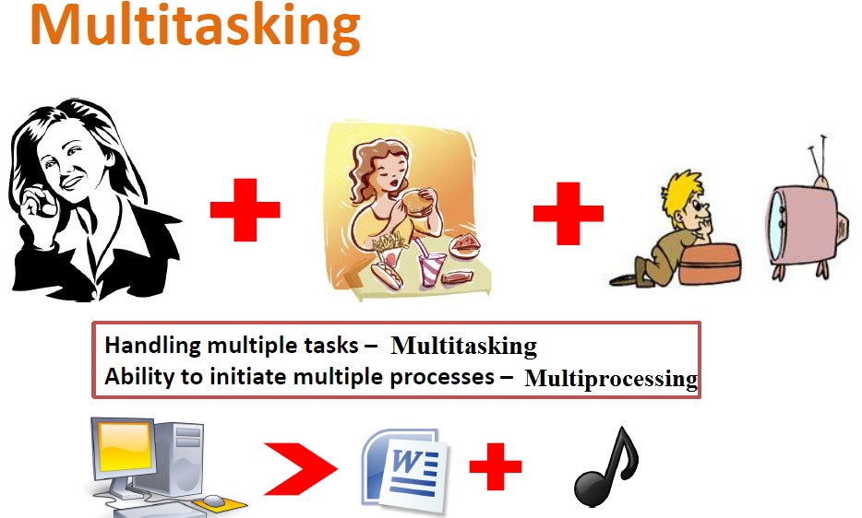

Slide 6
Thread-based Multitasking vs Process-based Multitasking
• Threads share the same address space.
• Context switching between threads is usually less expensive than between processes.
• The cost of communication between threads is relatively low.

Slide 7
Types of Thread
• User Thread
• Daemon Thread (Garbage collector, Spell Checker)

Slide 8
Thread Creation
Implementing threads is achieved in one of two ways:
• extending the java.lang.Thread class
• implementing the java.lang.Runnable interface

Slide 9
Thread Creation (By extending Thread Class )
class Multi extends Thread{
public void run(){
System.out.println("thread is running...");
}
public static void main(String args[]){
Multi t1=new Multi();
t1.start();
} }

Slide 10
Thread Creation (By implementing Runnable interface)
class Multi implements Runnable{
public void run(){
System.out.println("thread is running...");
}
public static void main(String args[]){
Multi m1=new Multi();
Thread t1 =new Thread(m1);
t1.start();
} }

Slide 11
Implements Runnable vs extends Thread
When you extends Thread class, after that you can’t extend any other class which you required. (As you know, Java does not allow inheriting more than one class). When you implements Runnable, you can save a space for your class to extend any other class in future or now.

Slide 12
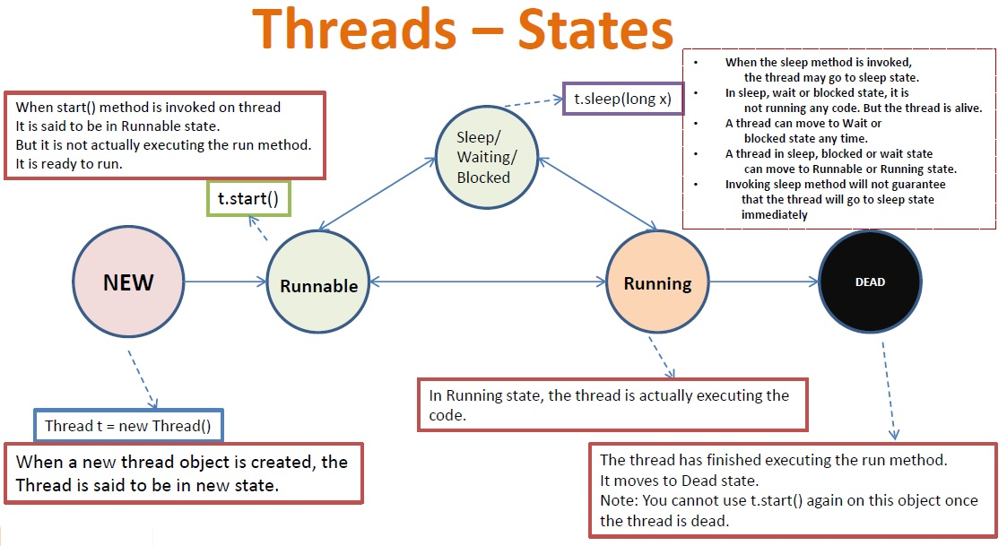
Thread Life Cycle

Slide 13
The life cycle of a Java thread
runnable
get the lock
blocked/waiting
not-running
(ready)
start()
new Thread(…)
sleep done
Thread.notify(), Thread.notifyAll()
new Thread(…)
interrupt()
(throw exception)
yield(), or
preempty
by OS
scheduled
by OS
running
Thread.wait()
Thread.sleep(…)
Thread.join()
terminated
stop(),
run() exits
normally or abnormally
blocked by lock

Slide 14
Thread Methods (sleep())
class SleepEx extends Thread{
public void run(){
for(int i=1;i<5;i++){
try{
Thread.sleep(5000); // in miliseconds
//Tread.sleep(5000,1000);//inmiliseconds, nanoseconds
}catch (InterruptedException e){
System.out.println(e);
}
System.out.println(i);
}
public static void main(String args[]){
SleepEx t1=new SleepEx();
SleepEx t2=new SleepEx();
t1.start();
t2.start();
}

Slide 15
Thread Methods (Naming Thread and Current Thread)
class NamingEx extends Thread{
public void run(){
System.out.println(Thread.currentThread().getName());
}
public static void main(String args[]){
NamingEx t1=new NamingEx();
NamingEx t2=new NamingEx();
t1.start();
t2.start();
}
}

Slide 16
Thread Methods (Naming Thread and Current Thread)
class NamingEx extends Thread{
public void run(){
System.out.println(Thread.currentThread().getName());
}
public static void main(String args[]){
NamingEx t1=new NamingEx();
// NamingEx t1=new NamingEx(“MyThread1”);
System.out.println("Name of t1:"+t1.getName());
t1.setName(“Student”);
t1.start();
}
}

Slide 17
Thread Methods (Join Thread)
public static void main(String args[]){
JoinEx t1=new JoinEx();
JoinEx t2=new JoinEx();
JoinEx t3=new JoinEx();
t1.start();
try{
t1.join(); // join(miliseconds)
}catch(Exception e){System.out.println(e);}
t2.start();
t3.start();
}
class JoinEx extends Thread{
public void run(){
for(int i=1;i<=5;i++){
try{
Thread.sleep(500);
}catch(Exception e){
System.out.println(e);
}
System.out.println(i);
}
}

Slide 18
Thread Methods (Thread Priority)
class NamingEx extends Thread{
public void run(){
System.out.println(Thread.currentThread().getName());
}
public static void main(String args[]){
NamingEx t1=new NamingEx();
System.out.println("Name of t1:"+t1.getPriority());
t1.setPriority(Thread.MIN_PRIORITY); // 1
t1.setPriority(Thread.MAX_PRIORITY); //10
t1.setPriority(Thread.NORM_PRIORITY); // 5
t1.start(); } }

Slide 19
Problem with Thread
Account
X
Min Balance: 1000
Avail Balance: 2000
Withdraw 1000
Withdraw 1000
Context Switch
Person- P2
Person- P1
Min Balance: 1000
Avail Balance: 2000
Min Balance: 1000
Avail Balance: 2000
Dirty Data

Slide 20
Solution
Account
X
Min Balance: 1000
Avail Balance: 2000
If(Lock is Avail){
Withdraw 1000
}
If(Lock is Avail){
Withdraw 1000
}
YES
NO
Context Switch
Person- P2
Person- P1
Min Balance: 1000
Avail Balance: 2000

Slide 21
Thread Synchronization
Threads share the same memory space, i.e., they can share resources. However, there are critical situations where it is desirable that only one thread at a time has access to a shared resource.
There are two ways in which execution of code can be synchronized.
by declaring synchronized methods
synchronized code blocks(static / non-static).

Slide 22
Thread Synchronization(Synchronization Method)
Class Table{
void printTable(int n){
for(int i=1;i<=5;i++){
System.out.println(n*i);
try{
Thread.sleep(400);
}catch(Exception e){
System.out.println(e);}
} } }
MyThread1 t1=new MyThread1(obj);
MyThread2 t2=new MyThread2(obj);
t1.start();
t2.start();
t1.printTable(5);
t2.printTable(50);

Slide 23
Thread Synchronization(Synchronization Method)
Class Table{
synchronized void printTable(int n){
for(int i=1;i<=5;i++){
System.out.println(n*i);
try{
Thread.sleep(400);
}catch(Exception e){
System.out.println(e);}
}
}
}
MyThread1 t1=new MyThread1(obj);
MyThread2 t2=new MyThread2(obj);
t1.start();
t2.start();
t1.printTable(5);
t2.printTable(50);

Slide 24
Thread Synchronization(Synchronization Block)
Class Table{
void printTable(int n){
synchronized(this){
for(int i=1;i<=5;i++){
System.out.println(n*i);
try{
Thread.sleep(400);
}catch(Exception e){
System.out.println(e);}
}
} } }
MyThread1 t1=new MyThread1(obj);
MyThread2 t2=new MyThread2(obj);
t1.start();
t2.start();
t1.printTable(5);
t2.printTable(50);

Slide 25
Thread Synchronization(Synchronization Block)
Class Table{
static void printTable(int n){
synchronized(Table.class){
for(int i=1;i<=5;i++){
System.out.println(n*i);
try{
Thread.sleep(400);
}catch(Exception e){
System.out.println(e);}
}
} } }
MyThread1 t1=new MyThread1(obj);
MyThread2 t2=new MyThread2(obj);
t1.start();
t2.start();
t1.printTable(5);
t2.printTable(50);

Slide 26
Deadlock
A deadlock is a situation where a thread is waiting for an object lock that another thread holds, and this second thread is waiting for an object lock that the first thread holds. Since each thread is waiting for the other thread to relinquish a lock, they both remain waiting forever in the Blocked-for-lock-acquisition state. The threads are said to be deadlocked.

Slide 27
Deadlock (Example)
THREAD: t1
synchronized (resource1) {
System.out.println("locked resource 1");
try { Thread.sleep(100);}
catch (Exception e) {}
synchronized (resource2) {
System.out.println("locked resource 2");
}
THREAD: t2
synchronized (resource2) {
System.out.println("locked resource 1");
try { Thread.sleep(100);}
catch (Exception e) {}
synchronized (resource1) {
System.out.println("locked resource 2");
}

Slide 28
Deadlock Solution (Inter-thread communication)
Inter-thread communication is a mechanism in which a thread is paused running in its critical section and another thread is allowed to enter (or lock) in the same critical section to be executed. It is implemented by following methods of Object class:
  wait()
  notify()
  notifyAll()

Slide 29
Review Questions

Slide 30
1. Which is the correct way to start a new thread?
Select the one correct answer.
(a) Just create a new Thread object. The thread will start automatically.
(b) Create a new Thread object and call the method begin().
(c) Create a new Thread object and call the method start().
(d) Create a new Thread object and call the method run().
(e) Create a new Thread object and call the method resume().

Slide 31
ANSWER : (c)
Create a new Thread object and call the method start(). The call to the start()
method will return immediately and the thread will start executing the run()
method asynchronously.

Slide 32
2. When extending the Thread class to implement the code executed by a thread, which method should be overridden?
Select the one correct answer.
(a) begin()
(b) start()
(c) run()
(d) resume()
(e) behavior()

Slide 33
ANSWER : (c)
When extending the Thread class, the run() method should be overridden to provide the code executed by the thread. This is analogous to implementing the run()method of the Runnable interface

Slide 34
3. Which statements are true?
Select the two correct answers.
(a) The class Thread is abstract.
(b) The class Thread implements Runnable.
(c) The Runnable interface has a single method named start.
(d) Calling the method run() on an object implementing Runnable will create a new thread.
(e) A program terminates when the last user thread finishes.

Slide 35
ANSWER : (b) and (e)
The Thread class implements the Runnable interface and is not abstract. A program terminates when the last user thread finishes. The Runnable interface has a single method named run. Calling the run() method on a Runnable object does not necessarily create a new thread; the run() method is executed by a thread. Instances of the Thread class must be created to spawn new threads.

Slide 36
4. What will be the result of attempting to compile and run the following program?
public class MyClass extends Thread {
public MyClass(String s) { msg = s; }
String msg;
public void run() {
System.out.println(msg);
}
public static void main(String[] args) {
new MyClass("Hello");
new MyClass("World");
}
}
Select the one correct answer.
(a) The program will fail to compile.
(b) The program will compile without errors and will print Hello and World, in
that order, every time the program is run.
(c) The program will compile without errors and will print a never-ending
stream of Hello and World.
(d) The program will compile without errors and will print Hello and World when
run, but the order is unpredictable.
(e) The program will compile without errors and will simply terminate without
any output when run.

Slide 37
ANSWER : (e)
The program will compile without errors and will simply terminate without any
output when run. Two thread objects will be created, but they will never be started. The start() method must be called on the thread objects to make the threads execute the run() method asynchronously.

Slide 38
5. What will be the result of attempting to compile and run the following program?
class Extender extends Thread {
public Extender() { }
public Extender(Runnable runnable) {super(runnable);}
public void run() {System.out.print("|Extender|");}
}
public class Implementer implements Runnable {
public void run() {System.out.print("|Implementer|");}
public static void main(String[] args) {
new Extender(new Implementer()).start(); // (1)
new Extender().start(); // (2)
new Thread(new Implementer()).start(); // (3)}}

Slide 39
Select the one correct answer.
(a) The program will fail to compile.
(b) The program will compile without errors and will print |Extender| twice and | Implementer | once, in some order, every time the program is run.
(c) The program will compile without errors and will print|Extender| once and|Implementer| twice, in some order, every time the program is run.
(d) The program will compile without errors and will print |Extender| once and | Implementer | once, in some order, every time the program is run
(e) The program will compile without errors and will simply terminate without any output when run.
(f) The program will compile without errors, and will print |Extender| once and Implementer| once, in some order, and terminate because of an runtime error.

Slide 40
ANSWER : (b)
(1) results in the run() method of the Extender class being called, which overrides the method from the Thread class, as does (2). (3) results in the run() method of the Implementer class being called.
Invoking the start() method on a subclass of the Thread class always results in the overridden run() method being called, regardless of whether a Runnable is passed in a constructor of the subclass.

Slide 41
6. What will be the result of attempting to compile and run the following program?
class R1 implements Runnable {
public void run() {
System.out.print(Thread.currentThread().getName());
}}
public class R2 implements Runnable {
public void run() {
new Thread(new R1(),"|R1a|").run();
new Thread(new R1(),"|R1b|").start();
System.out.print(Thread.currentThread().getName());
}
public static void main(String[] args) {
new Thread(new R2(),"|R2|").start();
}}

Slide 42
Select the one correct answer.
(a) The program will fail to compile.
(b) The program will compile without errors and will print |R1a| twice and |R2|once, in some order, every time the program is run.
(c) The program will compile without errors and will print|R1b| twice and |R2|once, in some order, every time the program is run.
(d) The program will compile without errors and will print |R1b| once and |R2|twice, in some order, every time the program is run.
(e) The program will compile without errors and will print |R1a| once, |R1b|once, and |R2| once, in some order, every time the program is run.

Slide 43
ANSWER : (d)
Note that calling the run() method on a Thread object does not start a thread.
However, the run() method of the Thread class will invoke the run() method of the Runnable object that is passed as argument in the constructor call. In other words, the run() method of the R1 class is executed in the R2 thread, i.e., the thread that called the run() method of the Thread class.

Slide 44
7. What will be the result of attempting to compile and run the following program?
public class Threader extends Thread {
Threader(String name) {
super(name); }
public void run() throws IllegalStateException {
System.out.println(Thread.currentThread().getName());
throw new IllegalStateException();
}
public static void main(String[] args) {
new Threader("|T1|").start();
}}

Slide 45
Select the one correct answer.
(a) The program will fail to compile.
(b) The program will compile without errors, will print |T1|, and terminate normally every time the program is run.
(c) The program will compile without errors, will print|T1|, and throw an IllegalStateException,
every time the program is run.
(d) None of the above.

Slide 46
ANSWER : (c)
Note that the complete signature of the run() method does not specify a throws
clause, meaning it does not throw any checked exceptions. However, it can always be implemented with a throws clause containing unchecked exceptions, as is the case in the code above.

Slide 47
8. What will be the result of attempting to compile and run the following program?
public class Worker extends Thread {
public void run() {
System.out.print("|work|");
}
public static void main(String[] args) {
Worker worker = new Worker();
worker.start();
worker.run();
worker.start();
}
}

Slide 48
Select the one correct answer.
(a) The program will fail to compile.
(b) The program will compile without errors, will print |work| twice, and terminate normally every time the program is run.
(c) The program will compile without errors, will print|work| three times, and terminate normally every time the program is run.
(d) The program will compile without errors, will print|work| twice, and throw an IllegalStateException, every time the program is run.
(e) None of the above.

Slide 49
ANSWER : (d)
The call to the run() method just executes the method in the main thread. Once a thread has terminated, it cannot be started by calling the start() method as shown above. A new thread must be created and started.

Slide 50
9. Given the following program, which statements are guaranteed to be true?
public class ThreadedPrint {
static Thread makeThread(final String id, boolean daemon) {
Thread t = new Thread(id) {
public void run() { System.out.println(id);
}
};
t.setDaemon(daemon);
t.start();
return t;
}
public static void main(String[] args) {
Thread a = makeThread("A", false);
Thread b = makeThread("B", true);
System.out.print("End\n");
}
}

Slide 51
Select the two correct answers.
(a) The letter A is always printed.
(b) The letter B is always printed.
(c) The letter A is never printed after End.
(d) The letter B is never printed after End.
(e) The program might print B, End, and A, in that order.

Slide 52
ANSWER : (a) and (e)
Because the exact behavior of the scheduler is undefined, the text A, B, and End can be printed in any order. The thread printing B is a daemon thread, which means that the program may terminate before the thread manages to print the letter. Thread A is not a daemon thread, so the letter A will always be printed

Slide 53
10.Given the following program, which alternatives would make good choices to synchronize
on at (1)?
public class Preference {
private int account1;
private Integer account2;
public void doIt() {
final Double account3 = new Double(10e10);
synchronized(/* ___(1)___ */) {
System.out.print("doIt");
}}}
Select the two correct answers.
(a) Synchronize on account1.
(b) Synchronize on account2.
(c) Synchronize on account3.
(d) Synchronize on this.

Slide 54
ANSWER : (b) and (d)
We cannot synchronize on a primitive value. Synchronizing on a local object is useless, as each thread will create its own local object and it will not be a shared
resource.

Slide 55
11.Which statements are not true about the synchronized block?
Select the three correct answers.
(a) If the expression in a synchronized block evaluates to null, a NullPointer- Exception will be thrown.
(b) The lock is only released if the execution of the block terminates normally.
(c) A thread cannot hold more than one lock at a time.
(d) Synchronized statements cannot be nested.
(e) The braces cannot be omitted even if there is only a single statement to execute in the block.

Slide 56
ANSWER : (b) , (c) and (d)
The lock is also released when an uncaught exception occurs in the block.

Slide 57
12.Which statement is true?
Select the one correct answer.
(a) No two threads can concurrently execute synchronized methods on the same object.
(b) Methods declared synchronized should not be recursive, since the object lock will not allow new invocations of the method.
(c) Synchronized methods can only call other synchronized methods directly.
(d) Inside a synchronized method, one can assume that no other threads are currently executing any other methods in the same class.

Slide 58
ANSWER : (a)
No two threads can concurrently execute synchronized methods on the same
object. This does not prevent one thread from executing a non-synchronized
method while another thread executes a synchronized method on the same object. The synchronization mechanism in Java acts like recursive semaphores, which means that during the time a thread owns the lock, it may enter and re-enter any region of code associated with the lock, so there is nothing wrong with recursive synchronized calls. Synchronized methods can call other synchronized and nonsynchronized methods directly

Slide 59
13.Given the following program, which statement is true?
public class MyClass extends Thread {
static Object lock1 = new Object();
static Object lock2 = new Object();
static volatile int i1, i2, j1, j2, k1, k2;
public void run() { while (true) { doIt(); check(); } }
void doIt() {
synchronized(lock1) { i1++; }
j1++;
synchronized(lock2) { k1++; k2++; }
j2++;
synchronized(lock1) { i2++; } }
void check() {
if (i1 != i2) System.out.println("i");
if (j1 != j2) System.out.println("j");
if (k1 != k2) System.out.println("k");
}
public static void main(String[] args) {
new MyClass().start();
new MyClass().start();
}}

Slide 60
Select the one correct answer.
(a) The program will fail to compile.
(b) One cannot be certain whether any of the letters i, j, and k will be printed during execution.
(c) One can be certain that none of the letters i, j, and k will ever be printed during execution.
(d) One can be certain that the letters i and k will never be printed during execution.
(e) One can be certain that the letter k will never be printed during execution.

Slide 61
ANSWER : (b)
One cannot be certain whether any of the letters i, j, and k will be printed during execution. For each invocation of the doIt() method, each variable pair is incremented and their values are always equal when the method returns. The only way a letter could be printed would be if the method check() was executed between the time the first and the second variable were incremented. Since the check() method does not depend on owning any lock, it can be executed at any time, and the method doIt() cannot protect the atomic nature of its operations by acquiring locks.

Slide 62
14. Given the following program, which code modifications will result in both threads
being able to participate in printing one smiley (:-)) per line continuously?
public class Smiley extends Thread {
pulic void run() { // (1)
while(true) { // (2)
try { // (3)
System.out.print(":"); // (4)
sleep(100); // (5)
System.out.print("-"); // (6)
sleep(100); // (7)
System.out.println(")"); // (8)
sleep(100); // (9)
} catch (InterruptedException e) {
e.printStackTrace();
} } }
public static void main(String[] args) {
new Smiley().start();
new Smiley().start();
}
}

Slide 63
Select the two correct answers.
(a) Synchronize the run() method with the keyword synchronized, (1).
(b) Synchronize the while loop with a synchronized(Smiley.class) block, (2).
(c) Synchronize the try-catch construct with a synchronized(Smiley.class) block,(3).
(d) Synchronize the statements (4) to (9) with one synchronized(Smiley.class) block.
(e) Synchronize each statement (4), (6), and (8) individually with a synchronized (Smiley.class) block.
(f) None of the above will give the desired result.

Slide 64
ANSWER : (c) and (d)
First note that a call to sleep() does not release the lock on the Smiley.class object once a thread has acquired this lock. Even if a thread sleeps, it does not release any locks it might possess.
(a) does not work, as run() is not called directly by the client code.
(b) does not work, as the infinite while loop becomes the critical region and the lock will never be released. Once a thread has the lock, other threads cannot participatein printing smileys.
(c) works, as the lock will be released between each iteration, giving other threads the chance to acquire the lock and print smileys.

Slide 65
(d) works for the same reason as (c), since the three print statements will be executed as one atomic operation.
(e) may not work, as the three print statements may not be executed as one atomic operation, since the lock will be released after each print statement.
Synchronizing on this does not help, as the printout from each of the three print
statements executed by each thread can be interspersed.

Slide 66
15. Given:
public static synchronized void main(String[] args) throws InterruptedException {
Thread t = new Thread();
t.start();
System.out.print("X");
t.wait(10000);
System.out.print("Y");
}
What is the result of this code?
A. It prints X and exits
B. It prints X and never exits
C. It prints XY and exits almost immediately
D. It prints XY with a 10-second delay between X and Y
E. It prints XY with a 10,000-second delay between X and Y
F. The code does not compile
G. An exception is thrown at runtime

Slide 67
ANSWER : (G)
The code does not acquire a lock on t before calling t.wait(), so it throws an IllegalMonitorStateException. The method is synchronized, but it's not synchronized on t so the exception will be thrown. If the wait were placed inside a synchronized(t) block, then D would be correct.

Slide 68
16. Which are true? (Choose all that apply.)
A. The notifyAll() method must be called from a synchronized context
B. To call wait(), an object must own the lock on the thread
C. The notify() method is defined in class java.lang.Thread
D. When a thread is waiting as a result of wait(), it releases its lock
E. The notify() method causes a thread to immediately release its lock
F. The difference between notify() and notifyAll() is that notifyAll() notifies all
waiting threads, regardless of the object they're waiting on

Slide 69
ANSWER :
A is correct because notifyAll() (and wait() and notify()) must be called from
within a synchronized context. D is a correct statement.
B is incorrect because to call wait(), the thread must own the lock on the object that wait() is being invoked on, not the other way around. C is incorrect because notify() is defined in java.lang.Object. E is incorrect because notify() will not cause a thread to release its locks. The thread can only release its locks by exiting the synchronized code. F is incorrect because notifyAll() notifies all the threads waiting on a particular locked object, not all threads waiting on any object.

Slide 70
17. Given
class MyThread extends Thread {
MyThread() {
System.out.print("MyThread ");
}
public void run() {
System.out.print("bar ");
}
public void run(String s) {
System.out.print("baz ");
}
}
public class TestThreads {
public static void main (String [] args) {
Thread t = new MyThread() {
public void run() {
System.out.print("foo ");
}
};
t.start();
} }
What is the result?

Slide 71
A. foo
B. MyThread foo
C. MyThread bar
D. foo bar
E. foo bar baz
F. bar foo
G. Compilation fails
H. An exception is thrown at runtime

Slide 72
ANSWER : (B)
B is correct. In the first line of main we're constructing an instance of an anonymous inner class extending from MyThread. So the MyThread constructor runs and prints MyThread. Next, main() invokes start() on the new thread instance, which causes the overridden run() method (the run() method in the anonymous inner class) to be invoked.

Slide 73
18. public class Leader implements Runnable {
public static void main(String[] args) {
Thread t = new Thread(new Leader());
t.start();
System.out.print("m1 ");
t.join();
System.out.print("m2 ");
}
public void run() {
System.out.print("r1 ");
System.out.print("r2 ");
} }
Which are true? (Choose all that apply.)
A. Compilation fails
B. The output could be r1 r2 m1 m2
C. The output could be m1 m2 r1 r2
D. The output could be m1 r1 r2 m2
E. The output could be m1 r1 m2 r2
F. An exception is thrown at runtime

Slide 74
ANSWER : (A)
The join() must be placed in a try/catch block. If it were, answers B and D would be correct. The join() causes the main thread to pause and join the end of the other thread, meaning "m2" must come last.

Slide 75
Programming Exercises

Slide 76
1. Declare an interface called Function that has a method named evaluate that takes an int parameter and returns an int value. Create a class called Half that implements the Function interface. The implementation of the method evaluate() should return the value obtained by dividing the int argument by 2. In a client, create a method that takes an arbitrary array of int values as a parameter, and returns an array that has the same length, but the value of an element in the new array is half that of the value in the corresponding element in the array passed as the parameter. Let the implementation of this method create an instance of Half, and use this instance to calculate values for the array that is returned.

Slide 77
1. Implement three classes: Storage, Counter, and Printer. The Storage class should store an integer. The Counter class should create a thread that starts counting from 0 (0, 1, 2, 3, ...) and stores each value in the Storage class. The Printer class should create a thread that keeps reading the value in the Storage class and printing it.
Write a program that creates an instance of the Storage class and sets up a Counter and a Printer object to operate on it.

Slide 78
2. Modify the program from the previous exercise to ensure that each number is printed exactly once, by adding suitable synchronization.

